Slide 1

NO need to
Stress about
Getting a
Good
Evaluator
anymore

Slide 2
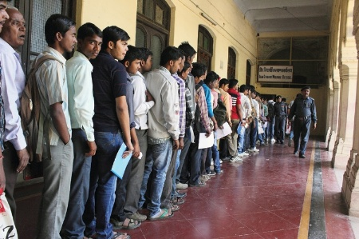
No more long
queues for revaluation

Slide 3





Real
Check

Slide 4
Our aim
To provide an automated subjective answer evaluation system.
Unbiased and uniform for all students
Purely based on content
Not affected by different types of evaluators-strictness, mood, circumstances
No more revaluation required
Be rest assured that checking is uniform and correctly done

Slide 5

So how does
this work?

Slide 6


Key concepts
Correct
Student
Bank

Slide 7
question
Q1.Explain the
process
of photosynthesis.

Slide 8
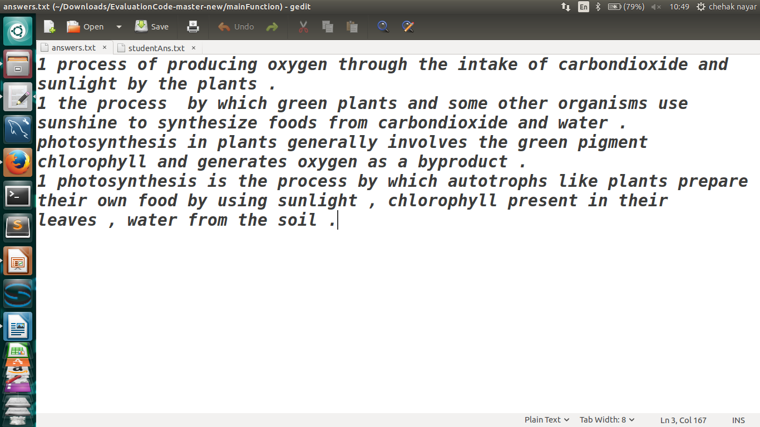
Correct answer database
Question Number

Slide 9
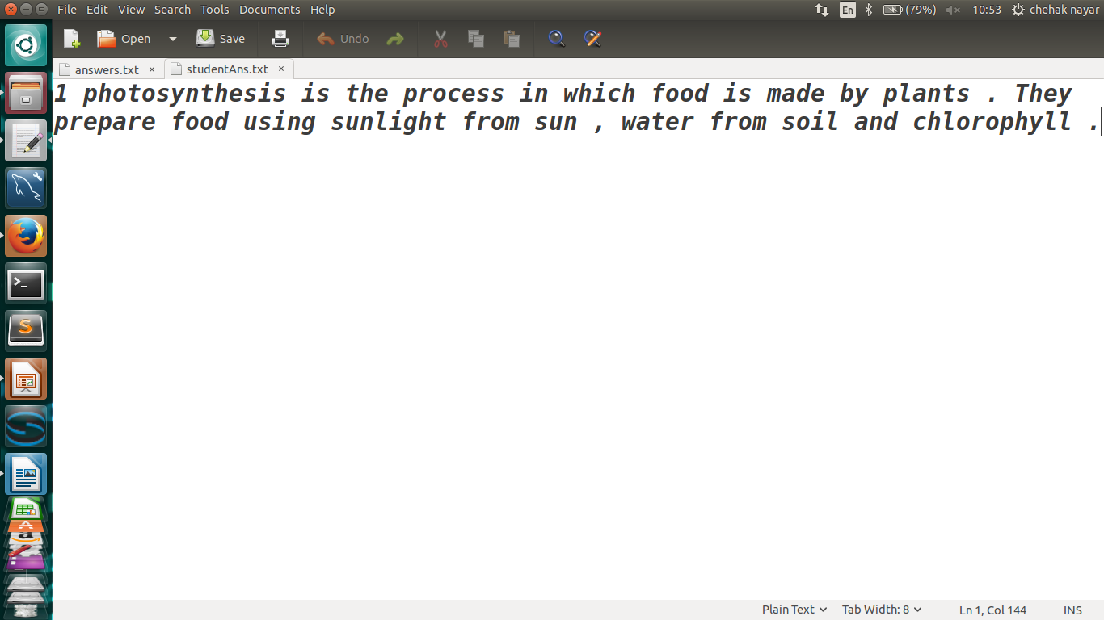
Student answer
Ans to Question Number
Notes:
Take one screenshot for ans written eg- I don’t know the ans.

Slide 10
The following procedure
Is applied to each answer:
Answers in ans bank
Student ans

Slide 11
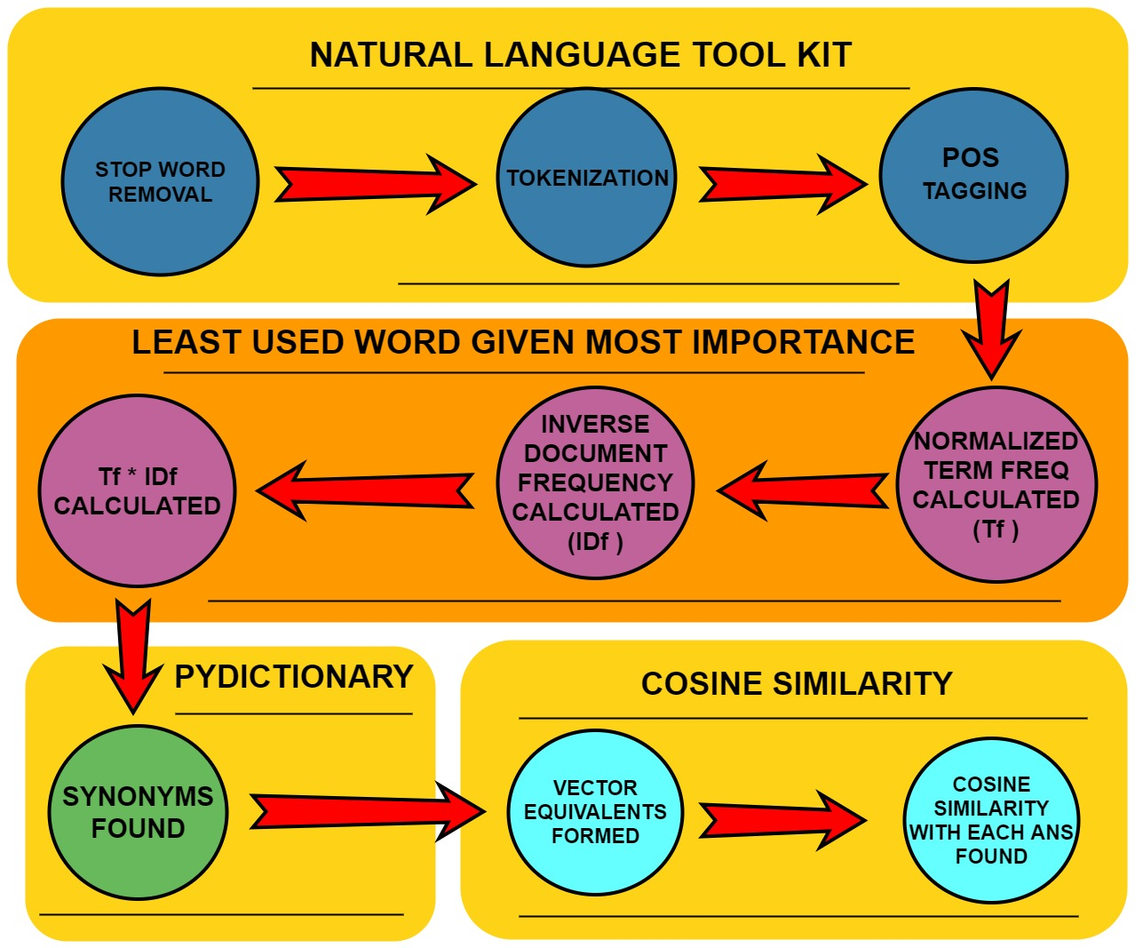

Slide 12
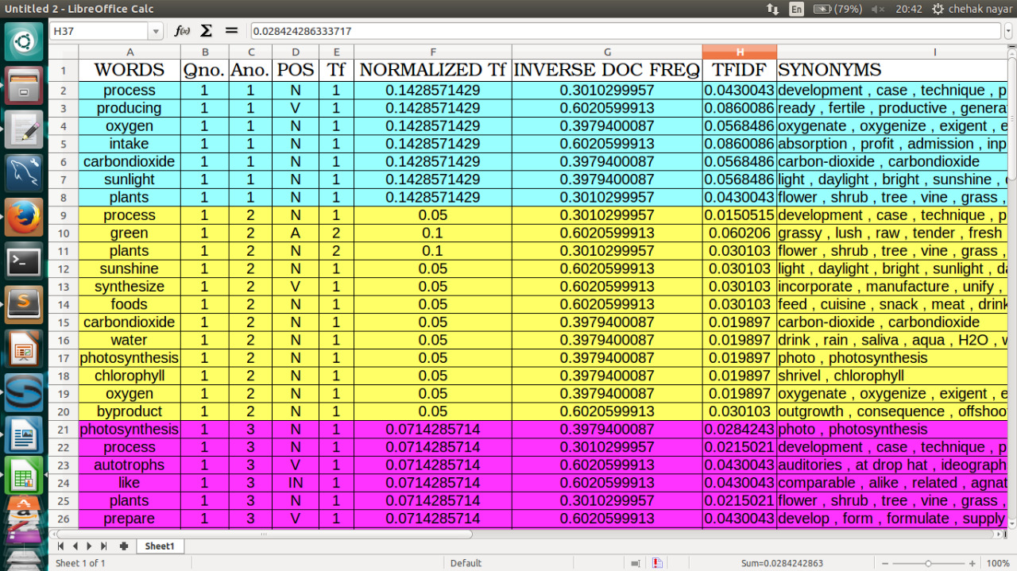
Answer bank

Slide 13
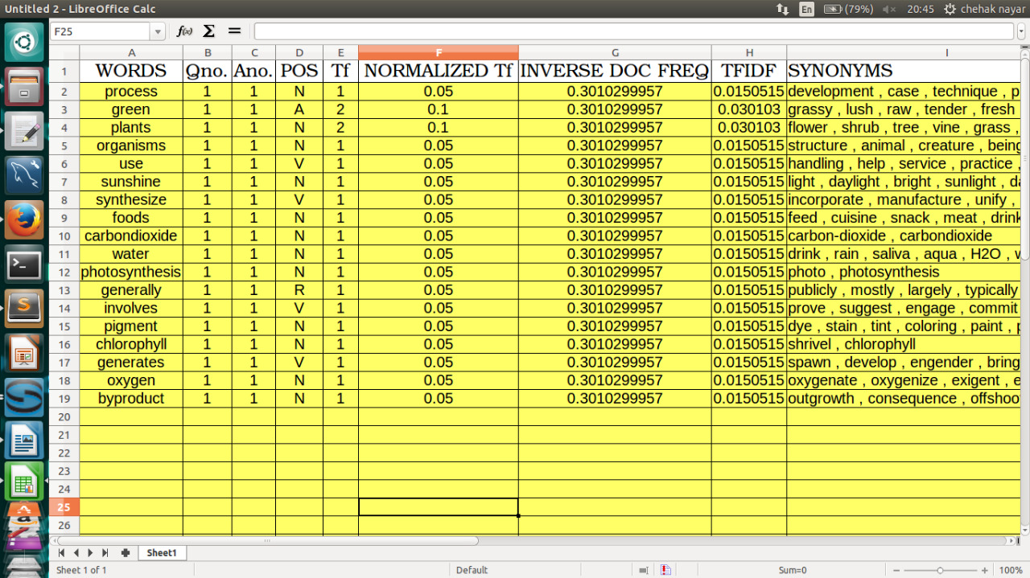
Student Answer

Slide 14
Representing word as a vector
girl
boy
guy
lad

Slide 16
It is possible to obtain a vector for each word in a sentence.
Each sentence can be represented as ai+bj+ck+… where a,b,c are TfIdf values of each word present in the sentence and i,j,k are unique vector directions given to them.

Slide 17
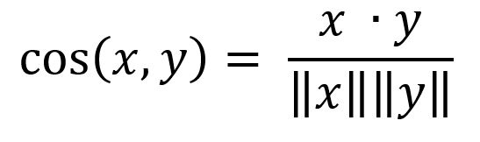
COSINE SIMILARITY is calculated by formula:
x
y
Where,
x=(ai+bj+ck+…)=student answer
y=(di+ej+fk+…)
=one ans from ans bank

Slide 18
While calculating dot product x.y, we consider two
words to have same directional vector if:
If both words are the EXACT SAME.
If a SYNONYM is used in the SAME SENSE as the word in correct ans.(POS)

Slide 19
Cosine similarity calculated

